Slide 1
Basic Computer Skills to navigate electronic health records
Module 1
Notes:
Welcome Audience
Make disclaimer for varied levels of expertise
Encourage questions and discussion especially between sections of module
Identify individuals that may need extra help
Placement of individuals needing extra help next to those that are more digitally savvy

Slide 2
Learning Outcomes
Upon completion of this course the learner will be able to:
Identify different types of computers systems and how they operate
Discuss the influence of ergonomics on computer usage
Understand the importance of the username and password when logging on and off of a computer
Identify common icons used to open software and applications
Know how to use Windows bars and functions such as: minimize, restore, resize, move, and close
Understand the concepts of web browsers and links to connect with web-based information I
Identify common documentation options and their use to enter, save, and edit information
Notes:
Review Learning Outcomes
This will help to organize the content and to increase learning through expectation and repeating terms

Slide 3
Computer Hardware
The collection of physical parts of a computer system is referred to as hardware.
Examples of hardware include:
Computers
Computer Parts
Computer Accessories
Notes:
Knowledge Check
Ask audience if they can give any examples of computer hardware

Slide 4
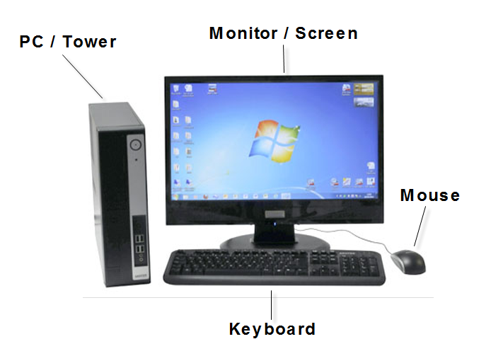
Desktop Computer
Notes:
Knowledge Check
Ask audience if they have a desktop computer or any experience with using a desktop computer

Slide 5
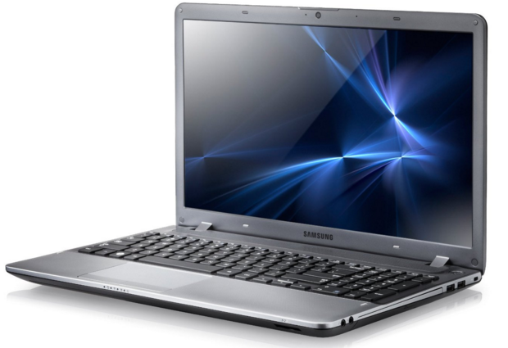
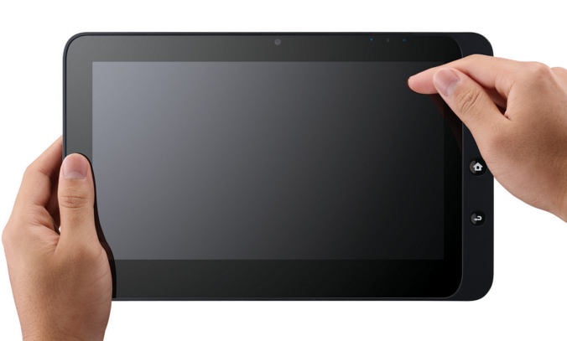
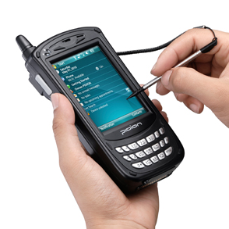
Other Types of Computers
Tablet
Laptop Computer
Handheld Computer
Notes:
Knowledge Check & Explain
Ask audience if they have any experience using other types of computers
Discuss the Smart Phone as a type of handheld computer
Explain how information is accessed differently when using different types of computers

Slide 6

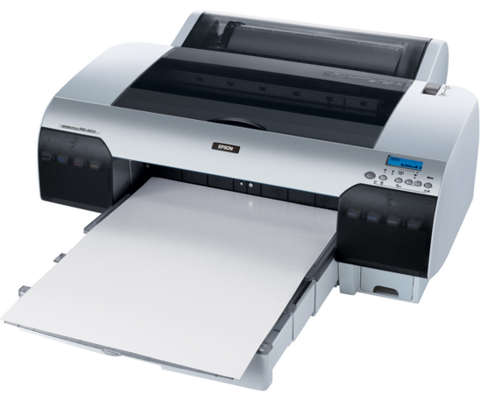
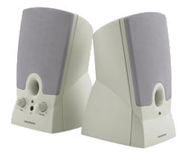
Computer Accessories
Printer
Headphones
Speakers
Notes:
Knowledge Check
Ask audience if they can name any other types of computer accessories (flash drive/thumb drive, remote control, projector)

Slide 7
Hardwired vs. Wireless Network
Hardwired is the term used when a device needs to be connected to wires in order to be used.
  Desktop Computer
  Accessories (speakers, printers, etc…that are NOT wireless)
Any computer network where wires are not necessary to connect to the system to send and receive information is called wireless.
  Tablet & Handheld
  Wireless Accessories
Notes:
Discussion
Discuss the various types of wireless devices and charging & maintenance

Slide 8
Computer Operating System
The basic functions of computers are facilitated by programs called the operating system.
The OS manages the computer’s memory, processes, and all of the software and hardware.
Examples of operating system programs include:
  Windows and Mac
These allow the computer to communicate with the user without knowing how to speak computer language.
Notes:
Explain
A computer operating system (also called a platform) may be difficult for some to grasp because it is multifaceted and cannot be seen
Simplify the terms
Ask audience if anyone has experience with entering or saving a document or pictures: use example of smart phone
Explain the difference between Windows and Mac

Slide 9
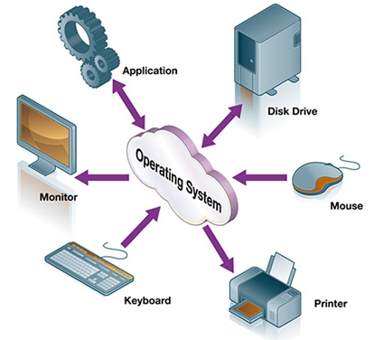
Computer Operating System
Notes:
Explain
Use diagram to further explain the function of the operating system when using various types of computers

Slide 10

The Internet
The global communication network that allows computers to connect and exchange information is called the internet.
Internet servers are computer programs that let users access the internet
This is also referred to as being online or accessing the World Wide Web
Notes:
Discuss
Examples of simple internet activities such as banking or shopping
Ask audience for examples of activities they perform. They may not know the terms internet or WWW.

Slide 11
Ergonomics
The science of designing and arranging equipment to maximize efficiency and safety is called ergonomics.
Some examples of ergonomics include:
Hardware arrangement & positioning
Body alignment and posture
Lighting
Notes:
Discuss
The importance of ergonomics
Efficiency in relation to the way the human body moves and functions (comfort)
Safety in relation to impact on human body
Physical stress from positioning or repetitive movements
Resting periods if spending prolonged hours on computer

Slide 12
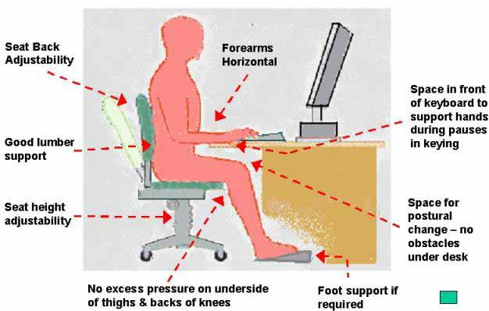
Ergonomics
Notes:
Explain
Use diagram to further explain ergonomics and safe computing
Discuss ergonomics in relation to the various types of computers (desk top, vs. tablet, vs. smart phone/handheld)

Slide 13
Knowledge Checkpoint
What types of computers uses a keyboard and mouse as opposed to touching the screen to interact?
Name three main accessories to a computer system.
What is the difference between a hardwired system and wireless system?
True or False: A computer’s operating system allows the computer to communicate with the user without knowing how to speak computer language.
True or False: Proper body alignment and posture will help to reduce strain and health problems associated with using computers.
Notes:
Knowledge Checkpoint Answers and Discussion (to verify learning)
Desktop & Some Laptop Computers
Keyboard, Mouse, Printer, Speakers, Headphones
Hardwired needs wires to use and connect, Wireless does not.
True
True

Slide 14

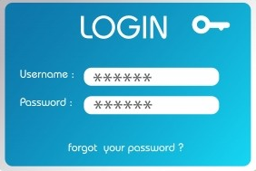
Computer Access
Turn on the PC or Modem and Screen
Log In
  User Name & Passwords
Icons
  Pictures or symbols that represent a location or command
    Applications
    Software
    Files & Folders
Notes:
Discuss & Explain
All computers have some type of power button. Power buttons may vary.
Discuss security related to log-in information and once logged in, that the computer will recognize and remember the user (digital signature)
Explain how icons work when hovering over them and clicking on them

Slide 15






Common Icons
Start Icon: Command Menu
Internet Explorer Icon: Internet/WWW
Printer Icon
Refresh Icon: Updates Display
Search icon
Home Icon
Notes:
Explain & Check Knowledge
Use diagram to further explain common icons
Ask for examples of other icons that they may have seen or used (Smart Phone Apps)

Slide 16
Window Bars
Title Bar – States name of program running
Menu Bar – Lists commands that can be selected
Tool Bar – Words or Icons that perform functions
Scroll Bar – Identifies position and allows up and down movement
Notes:
Explain & Relate
Examples are from the Windows Operating System
Bars in Mac Operating are similar

Slide 17
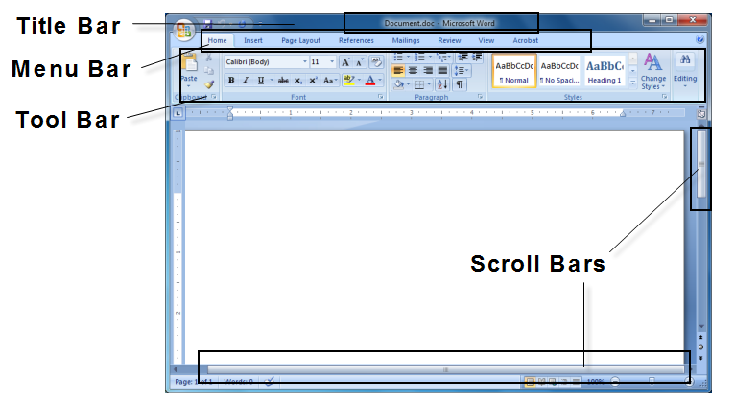
Window Bars
Notes:
Reinforce
Different functions of windows bars
Test audience by asking what bar they would use for various functions
Identify current program that computer is running (title bar)
Performing specific commands and functions (menu & tool bars)
Moving the viewing position to access additional information (scroll bar)

Slide 18
Window Functions
Minimize – Hide from view without closing
Restore – Return to view or previous size
Resize – Change height or width of view
Move – Move Window
Close – Close Window
Notes:
Explain & Relate
Examples are from the Windows Operating System
Functions in Mac Operating are similar

Slide 19
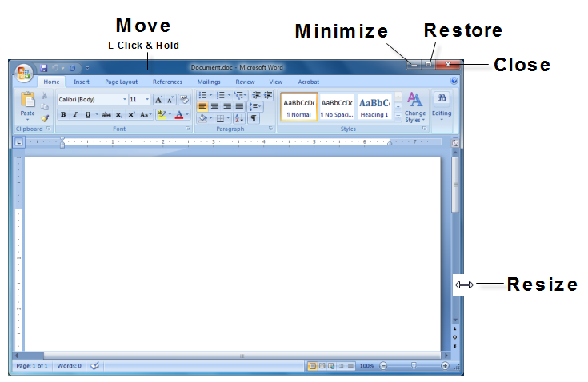
Window Functions
Notes:
Reinforce
Different functions of windows that change the view on the screen
Test audience by asking what icon they would use for various functions
Identify where to click to Move, Minimize, Restore, Resize, and Close

Slide 20
Web Browser
A computer program that provides a way to interact with information on the internet is called a web browser.
URL Address – an electronic address that when typed into the browser identifies and locates internet resources
Refresh – updates the display by sending a new signal
Notes:
Explain & Review
Refer back to Internet / WWW
Explain web browser as the avenue to access specific locations on the internet
Refer back to the Refresh icon

Slide 21
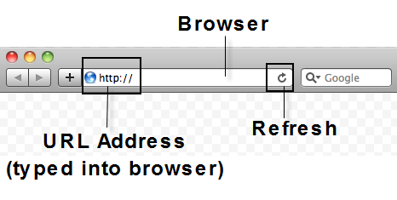
Web Browser
Notes:
Reinforce
Web Browser in picture is related to Mac operating system as opposed to Windows
Ask audience for examples of URL Addresses that they have used or could use (Amazon, Federal Government, Google)

Slide 22
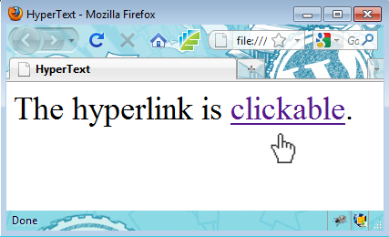
Links
Also called hyperlinks, links are words that are usually highlighted in blue. When selected links connect to web pages, websites, or text.
Notes:
Explain
The differences and similarities of links and URLs
Links are another pathway to access the internet
Links supplement information that is currently on screen
When documenting healthcare information, there may be a link to explain a fall scale or a skin scale

Slide 23
Knowledge Checkpoint
True or False: Some computers require a username and password to identify the person who is using it.
What are some common icons or pictures that computers use to identify locations?
What Windows bar identifies position and allows up and down movement?
What Windows function allows the user to hide the view from the screen without closing?
What is the computer program that provides a way to interact with information on the internet by typing in a URL address called?
Notes:
Knowledge Check Answers
True
Internet Explorer, Print, Refresh, Search, & Start
Scroll Bar
Minimize
Web Browser

Slide 24
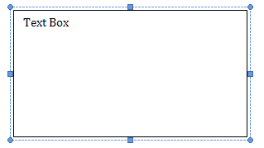
Documentation Terminology
Text Boxes & Text Fields are used to enter typed information into a document.
The area in a text box/field is limited to a specific number of characters.
Notes:
Explain & Check Knowledge
Ask if anyone has ever documented in a text box and what types of things were documented
Explain how a text box/field can be limited to a specific number of characters
Define characters as symbols & numbers
Explain how spaces are also included in the field count

Slide 25
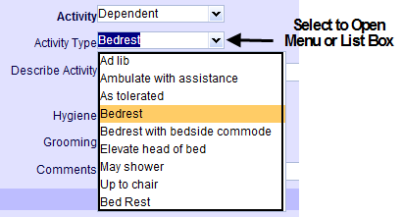
Documentation Terminology
Drop Down Menu & List Box – List of choices that can be activated when selected.
Notes:
Discuss & Check Knowledge
Ask if anyone has used a drop down menu and discuss purpose

Slide 26
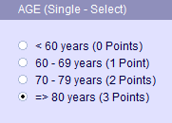
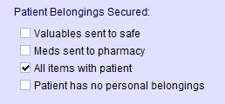
Documentation Terminology
Documentation can be made by selecting a radio button (circle) or check box (square) that is associated with a list of choices.
Radio Button
Check Box
Notes:
Discuss and Check Knowledge
Ask if anyone has ever used these types of documentation choices and discuss purpose

Slide 27
Documentation Entry
Some documentation entries require the use of Mouse & Keyboard Skills (instead of touch-screen contact)
Moving the mouse moves a pointer or a cursor across the computer screen
The wheel in the center of the mouse allows the user to scroll up and down
Clicking the left side of the mouse lets the user make a selection
Clicking the right side of the mouse activates a dropdown list for additional choices
Notes:
Check Knowledge & Explain
Reinforce the difference between touch-screen and mouse-keyboard use when interacting with the various types of computers.
Ask if anyone has ever used a mouse
Explain different functions of mouse
Moving
Left Click
Scroll
Right Click
Explain how the mouse pointer changes to a cursor when moved to text

Slide 28
Documentation Entry
Predefined Documentation Entries
Choosing from a limited, defined list
  Dropdown Menus
  Check Boxes
  Radio Buttons
Narrative Text
Typing into a text box or text field
Also called free text
Notes:
Explain & Discuss
Predefined Documentation as a means to limit the choices
Pros and Cons
Saves times to have selection as opposed to typing (narrative)
Data collection
What if the list does not have what you want to enter?
Comment field

Slide 29



Completing Documentation
Documentation entries must be saved once completed. There are many different icons associated with saving information.
Saving the documentation entry records the name of the individual that is associated with the log-in user name.
Notes:
Discuss & Check Knowledge
Various icons to save information
All entries associated with the user
Ask what would happen if the information entered was not saved

Slide 30
Documentation Editing
Documentation can be easily changed prior to saving by using the delete and backspace keys.
Delete erases text to the left of the curser
Backspace erases text to the right of the curser
Once saved, editing is specific to the computer program or software that is utilized.
Notes:
Explain
How to change documentation prior to saving
Explain how highlighting and using backspace/delete can erase more information more quickly
Editing information after saving
Don’t panic
Seek help and report issues
Enter corrected information

Slide 31

Documentation Responsibilities
Document information truthfully and thoroughly
Log Off Computer
  Security
  Protects information & user identity
HIPAA
  Confidentiality
Notes:
Check Knowledge, Discuss & Reinforce
Ask audience what responsibilities they have when documenting
Discuss confidentiality and log off as a means to protect user and patient

Slide 32
Knowledge Checkpoint
List three common documentation options that have set choices to select from.
True or False: Clicking the left side of the mouse lets the user make a selection.
Name two different ways to edit a computer entry.
True or False: Logging off of a computer can protect both information and user.
Notes:
Knowledge Checkpoint Answers
Check Boxes, List Boxes, Drop Downs, & Radio Buttons
True
Delete & Backspace
True

Slide 33
Basic Computer Skills Summary
You have learned about:
Types of computers and the similarities and differences in the way in which they function
The importance of ergonomics in relation to efficient and safe computing
Navigating within a computer in order to find information or go to a specific location
Various ways to enter and save documentation using a computer and the importance of logging off to protect information
Notes:
Summarize Learning

Slide 34

Questions
Thank You!
Notes:
Questions & Answers
Thank You!

Slide 35


Acknowledgements
This curriculum was developed with grant funding from The Healthcare Workforce Transformation Fund through the Commonwealth of Massachusetts, Executive office of Labor and Workforce Development. The grant project was administered by Commonwealth Corporation and The Massachusetts eHealth Institute.

